Slide 1
Reception and Institutionalization of English in India
Dr. P. Muralidhar Sharma
Assistant Professor
School of English
Gangadhar Meher University, Sambalpur

Slide 2
Introduction
Complex history embedded in colonial ideological framework
Varied cultural responses
Our implicated-ness in the process
English as a language of power
Notion of civilizational/cultural progress
Disciplinarity of English
Critical assessment of our roles as students of English
Textuality of ‘English’

Slide 3
Texts and Documents Predating Macaulay’s ‘Minute’
Charles Grant- “Observations on the State of Society among the Asiatic Subjects of Great Britain” (1792)
  English education as a means of cultural refinement
  Conversion to Christianity
  Window on the world
Dean Mahomet- Travels (1793-94)
  First Indian author to write a book in English
  Language and genre
  Professed submissiveness
  Constructed humility

Slide 4
Vennelakunty Soob Row- Letter to the Madras Schoolbook Society (1820)
  English education
  Reformation of pedagogy
Raja Ram Mohun Roy- Letter to Lord Amherst (1823)
  Sanskrit vs. English education
  Sanskrit as obsolete, pedantic
  ‘Liberal and enlightened’ system of education
  ‘Modern European Sciences’
H.L.V. Derozio- ‘Young Bengal’ Movement (1831)
  Thorough westernization
  Promotion of English through his students at Hindu College, Calcutta

Slide 5
T.B. Macaulay- “Minute” on Indian Education (1835)
Prompted by the favourable reaction of Indian intelligentsia
Anglicists vs. Orientalists
‘Mystical’ East and ‘Rational’ West
  “dialects commonly spoken among the natives of this part of India contain neither literary nor scientific information”, and as “so poor and rude that, until they are enriched from some other quarter, it will not be easy to translate any valuable work into them…a single shelf of a good European library was worth the whole native literature of India and Arabia”
Hybrid middle men
  “a class who may be interpreters between us and the million whom we govern—a class of people Indian in blood and colour, but English in tastes, in opinions, in morals and in intellect”
Modernization of vernaculars

Slide 6
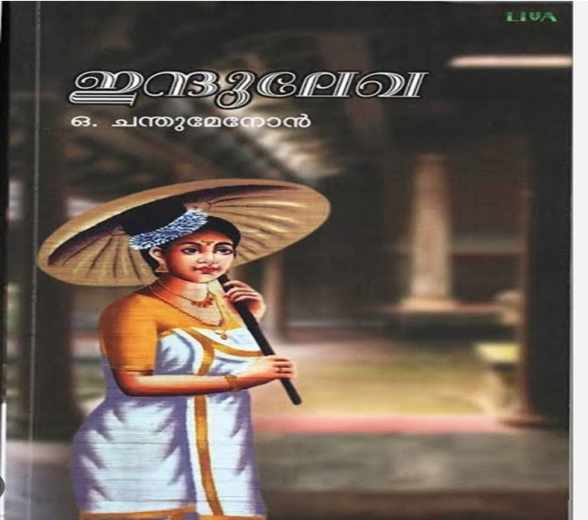
English and Vernacular Modernity
O Chandu Menon- Indulekha (1889)
  i. Novel in the ‘English’ fashion
  ii. English educated Nair woman
  iii. Exercise of her rationality
  iv. Independent choice of partner in marriage
  v. Foundations of modern femininity

Slide 7
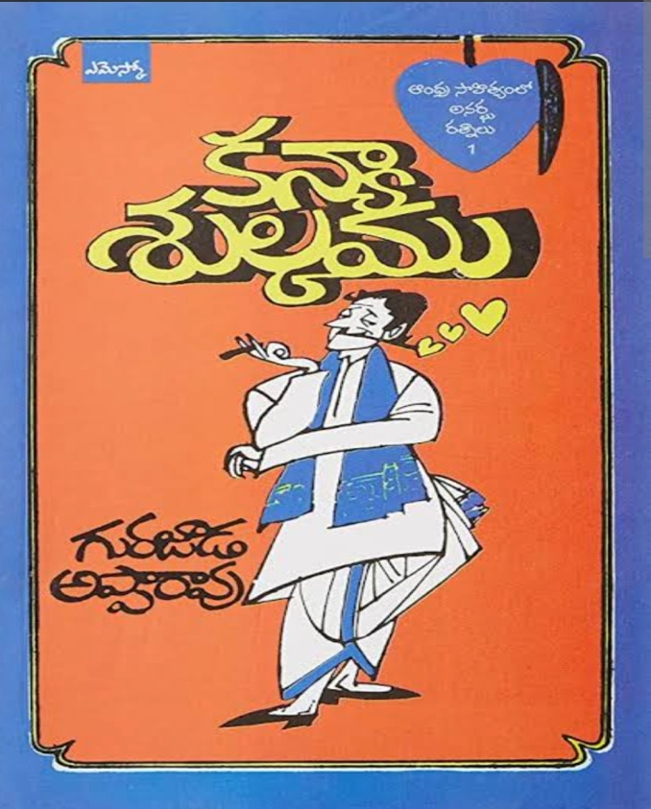
Gurajada Apparao- Kanyasulkam (1892)
  Endorsement of European learning
  Emergence of social consciousness
  Girisam, the English-speaking dandy
  Stringent critique of the civilizational role of English
  Failure of Enlightenment project

Slide 8
Conclusion
Consolidation of power
“Legitimization of British rule”- Gauri Vishwanathan, Masks of Conquest
Modernization of vernaculars- Susie Tharu
Formation of the category of ‘Indian Literature’
Rise of the novel and admonitory prose
Colonial to Postcolonial times- ‘Adopt’, ‘Adapt’, ‘Adept’
Disciplinary ‘burden’ of English

Slide 9
Thank you

